Slide 1
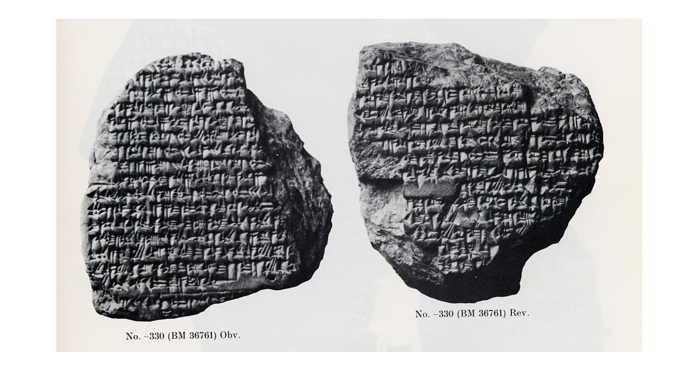
Week 3A: The Battle of Gaugamela; Babylon; Persia (Summer 331-Winter 330 BCE)
Babylonian Astronomical Diary in Cuneiform, mentioning Gaugamela and Alexander’s entry into Babylon (British Museum)

Slide 2
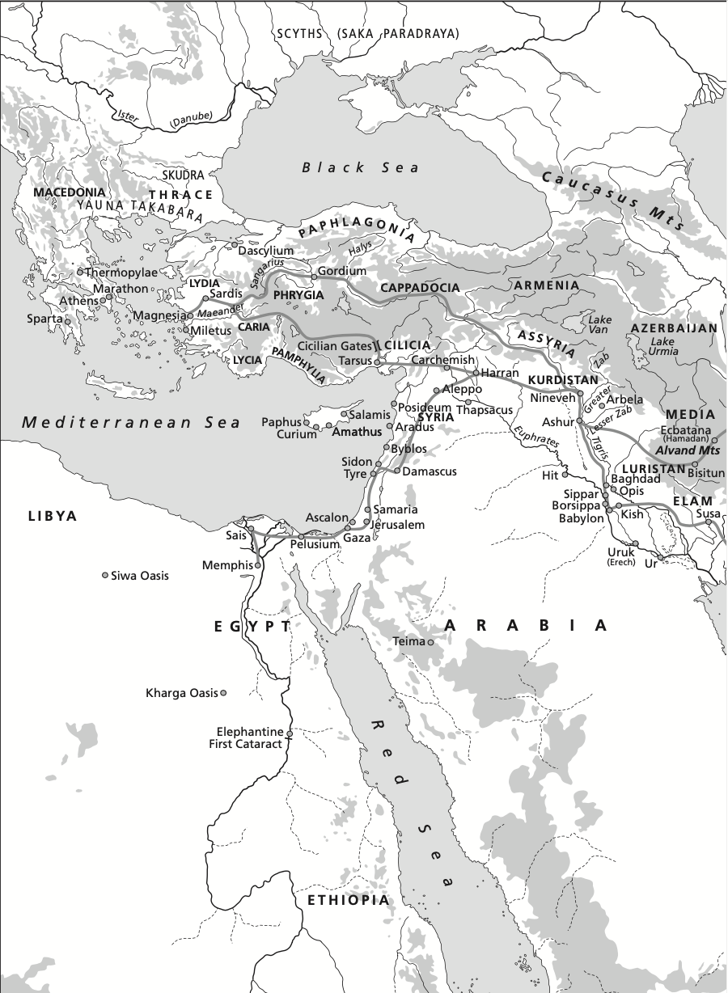
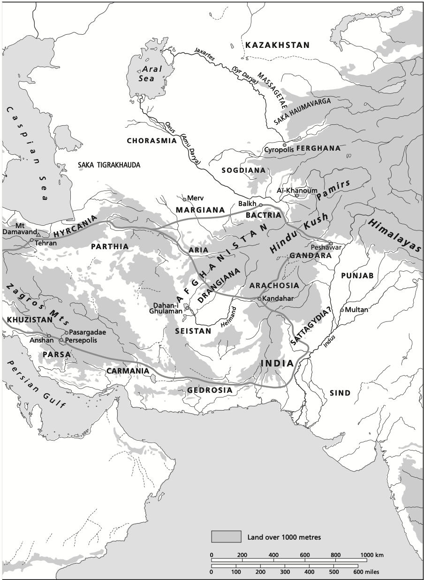

Slide 3
Events: The Battle of Gaugamela: Summer/Autumn 331
When we left Alexander, he had rejected a diplomatic offer from Darius while staying at Tyre. There he celebrated a major festival featuring some of the super-stars of the Greek world.
An Athenian embassy came to Alexander there, and requested the freedom of the Greek prisoners taken after the Granicus, which he granted (remember Agis’ revolt, ‘The Lacedaemonian War’ is ongoing!)
Darius’ diplomacy, A second thought: (John Ma) -> Darius is actually quite inventive in his administration of empire; cutting his losses in the West may have been unprecedented, but this was a time of major convulsion and may represent some of his innovation as Great King.
The debate with Parmenion may be fictional(ized), but probably reflects growing tensions between Alexander and his army, esp. older figures like Parmenion (a major theme ahead!)
With diplomacy out the window, both sides prepared for the next major confrontation, which would take place at Gaugamela, in the north of Mesopotamia (modern Iraq).

Slide 4
Events: The Battle of Gaugamela: Summer/Autumn 331
Darius’ army was this time gathered at Babylon, drawing primarily on the satrapies to the east (Bactria, Sogdiana, Scythian (Saca) cavalry) and central regions of the empire.
With no large contingent of Greek mercenaries this time, the strength of the Persian army was entirely in its cavalry, which certainly outnumbered, and was in many parts probably superior to the Macedonian cavalry.
Numbers for Darius’ force are (once again) WILD:
Arrian (3.8.6): 1,000,000 infantry and 400,000 cavalry
Diodorus (17.53.3): >800,000 infantry and >200,000 cavalry
Plutarch (31): 1,000,000 men total
Quintus Curtius (4.12.13): 200,000 infantry and 45,000 cavalry
Alexander: ~40,000 Infantry and 7,000 cavalry (Arrian 3.12.5)
This makes it impossible to reconstruct, but it is safe to say that a) Alexander was outnumbered, and b) particularly on the cavalry side.
Q) Although the cavalry gathered in the Persian army was of a very high quality, what is the major problem with this approach (terrible infantry, great cavalry) against A.?

Slide 5
Events: The Battle of Gaugamela: Oct. 1st 331
Some Important Figures at Gaugamela (Persian Side):
Bessus -> Satrap of Bactria; would later kill Darius and claim the throne name of Artaxerxes V; commands the cavalry on the left flank at Gaugamela (facing A.).
Mazaeus -> Satrap of Syria (previously Cilicia); will be appointed satrap of Babylonia by Alexander; commands the cavalry on the right flank at Gaugamela (facing Parmenion).
Atropates -> Satrap of Media; a few years later will be re-appointed by A.; later father-in-law of Perdiccas, who will serve as regent for a time after A.’s death.
Artabazus -> Formerly satrap of Hellespontine Phrygia; remained loyal to Darius after Gaugamela, but later appointed to Bactria by A.
Ariarathes -> Satrap of Cappadocia, which was not conquered by A.; predecessor of later independent Cappadocian kingdom (3rd-1st cent. BCE)
Orontes -> Satrap of Armenia; his son Mithrenes (formerly satrap of Lydia) was fighting on the Macedonian side, and would be named satrap in his father’s place.

Slide 6
Events: The Battle of Gaugamela: Oct. 1st 331
Some Important Figures at Gaugamela (Macedonian Side):
Hephaestion -> “Patroclus” to A.’s Achilles; probably command of somatophylakes (bodyguards), who fought closely with A.
Parmenion -> Command of the left flank at Gaugamela; conservative foil to Alexander’s boldness in our sources.
Philotas -> Parmenion’s son, friend of A., and commander of the companion cavalry (hetairoi).
Ptolemy -> One of A.’s somatophylakes; future Ptolemy I Soter and Alexander historian.
Seleucus -> Commander of the hypaspists (hypaspistai), the mobile hoplite-style infantry that were crucial to Macedonian strategy; later Seleucus I Nikator.
Antigonus -> Macedonian satrap of Phrygia and later Antigonus I Monophthalmus.
Cleitus (the Black) -> Saved A.’s life at Granicus; later promoted to command of companion cavalry w/ Hephaestion; later to be murdered by A. in a drunken argument.

Slide 7
Events: The Battle of Gaugamela: Oct. 1st 331
The Short Version - Babylonian Astronomical Diary:
That month, the eleventh (=Sept 18th), panic occurred in the camp before the king [the Macedonians] encamped in front of the king.
The twenty-fourth (=Oct. 1st), in the morning, the king of the world [erected his] standard [lacuna]. Opposite each other they fought and a heavy defeat of the troops [of the king he inflicted].The king, his troops deserted him and to their cities [they went] They fled to the land of the Guti.
The Long Version:
*The Macedonian march into Mesopotamia was fast and uninterrupted; Alexander reached the Euphrates river in July/August 331 (probably actually early Sept.), where Mazaeus had been stationed to prevent a bridge crossing. He did not oppose the crossing of the main army, being outnumbered.
*After a rapid march, the Macedonian army crossed the Tigris on Sept. 18th; Darius was waiting in the wide-open plain at Gaugamela, but did not oppose the crossing.

Slide 8
Events: The Battle of Gaugamela: Oct. 1st 331
With no opposition, Alexander was able to camp for several days. Darius was not going to move because he had carefully prepared the battlefield, the rough patches smoothed out to allow his scythe chariots to maneuver.
After Darius’ army was spotted, Arrian (3.9.3-4) reports Alexander actually taking Parmenion’s advice for once, to scout the battlefield rather than rush in to the fight.
Arrian (3.9.11) also tells us that while the Macedonians camped and rested, the Persian army remained in formation overnight -> psychological damage? exhaustion before battle?
More prophecy associated with this battle:
Callisthenes (Plut. 33) reported that before the battle Alexander prayed for help from Zeus and immediately an eagle was seen flying toward the Persian line (favoring an attack).
The seer Aristander had predicted (Arrian 3.15.7) that A. would win his battle in the same month as a lunar eclipse (seen after the crossing of the Tigris).
As Bosworth notes (pg. 81-2), the details of the battle are reported differently, and a comprehensive view of the battlefield would have been impossible because of the amount of dust

Slide 9
Events: The Battle of Gaugamela: Oct. 1st 331
The scale and conditions of the battle meant that each battalion and its commander was responsible for their own success -> communications between battalion commanders was essential.
Three accounts of Parmenion:
Arrian (3.10.1-2) -> “It is said” Parmenion advises A. to attack at night; A. refuses, must win an honorable open fight.
Arrian (3.15.1) -> Parmenion struggling on the left flank, sends messenger to A., who was pursuing the already fleeing Darius. Alexander receives message and charges to help, caught in heavy, slow fighting before he could reach Parmenion.
Plutarch (32) -> At the opening of the battle, Parmenion concerned about an attack on the baggage train, sends messenger to A., who responds with scorn and orders the attack on the right. Then later repeats Arrian’s scene, blaming Parmenion for Darius’ escape.
Plutarch (33): “In this battle, Parmenion is generally accused of having been sluggish and lacking in spirit, either because old age had dulled his courage, or because he had become envious of the authority and pomp, to use Callisthenes’ words, which Alexander now displayed.”
Diodorus (17.60.7) -> Parmenion sends to A. for help, but he couldn’t be reached and Parmenion fought bravely to hold the left flank.
Q) Can we now trace the source of anti-Parmenion bias in our sources? What might explain this particularly negative shift in the reporting of the battle?

Slide 10
Events: The Battle of Gaugamela: Oct. 1st 331
Arrian (3.14.3) – “the already fearful Darius could only see danger multiplied all around, and he was the first to turn and run.”
Astronomical Diary: “Opposite each other they fought and a heavy defeat of the troops [of the king he inflicted].The king, his troops deserted him and to their cities [they went] They fled to the land of the Guti.”
Q) Can we speculate on the most likely causes of the Macedonian victory at Gaugamela?
Whether he was quick or late to flee, Darius fled the battle along with Bessus and gathered men on his route to Ecbatana in Media, knowing Alexander would take the road to Babylon and Susa.
Mazaeus, meanwhile, fled for Babylon, where Alexander and his army would proceed over the next few weeks.

Slide 11
Post-Gaugamela: A Critical Juncture (Autumn 331)
How did the victory at Gaugamela impact the political and military situation?
Darius was still alive, and could (and would) prepare for another battle; nothing left to offer in diplomacy, but could still recruit from the upper satrapies w. Bessus.
Major reputational damage to Darius: A. was “King of the world” in Babylonian documents while Darius was still alive.
Susa and Babylon (and their massive treasuries) were won along with the battle.
Large contingent of reinforcements (c.15,000) arrive from Macedonia; army at least at its original strength.
The heartland of the Persian empire (Persis/Parsa) was still contested, but was without the Great King.
With Darius on the run, and the cities of Susa and Babylon his, how would Alexander deal with the administration of the Persian empire?
And how would those solutions go over with his army/Greek support at home? How could he counter possible resistance?

Slide 12
Babylon and Susa (Autumn/Winter 331)
* Alexander proceeded to Babylon, where he was given a triumphal welcome and the city was handed over by Mazaeus.
*Similar to Egypt, Babylon had its own distinct conceptions of kingship, religious considerations, and some history of resistance to Achaemenid rule.
*But similarly, problems in historiography, bias against Achaemenid empire in (heavily classics-centric) scholarship.
*Arrian (3.16.3-5) gives a very brief explanation of the welcome at Babylon: A. rebuilt (allowed? ordered?) the temple of Bel-Marduk (the Esagila) destroyed by Xerxes; he met with Chaldaean priests and made sacrifices; he appointed Mazaeus as satrap (he had a Babylonian wife).
In short, he was welcomed as a benevolent alternative to Persian rule…
Problems:
- The Esagila was not destroyed by Xerxes!
- Thus, there is no solid basis for assuming A. was welcomed as a ‘liberator’ (much as in our study of Egypt)
- Mazaeus may have had a Babylonian wife, but he was yet another Persian satrap!

Slide 13
Babylon and Susa (Autumn/Winter 331)
*Arrian (3.16.3) says Alexander advanced on the city in battle formation; he was at least prepared for resistance…
*Why did Mazaeus not resist? Probably for the same reason as most other cities in the same situation!
Babylonian Astronomical Diary:
That month, from the first to the [lacuna], came to Babylon, saying: "Esagila [will be restored] and the Babylonians to the treasury of Esagila [their tithe will give."]
On the eleventh, in Sippar an order of Al[exander to the Babylonians was sent as follow]s: "Into your houses I shall not enter.”
On the thirteenth, [the vanguard advanced to the Sikil]la gate, to the outer gate of Esagila and [the Babylonians prostrated themselves].
On the fourteenth, these Ionians a bull [lacuna] short, fatty tissue [lacuna]. Alexander, king of the world, came into Babylon [lacuna], horses and equipment of [lacuna] and the Babylonians and the people of [lacuna] a message to…. (End of Tablet)
Kuhrt: The “Re-building” of the Esagila was a ritual approval of Alexander’s kingship; it had not been destroyed, but was a ceremony to confirm and solemnize his rule (the Chaldaean rituals?)

Slide 14
Babylon and Susa (Autumn/Winter 331)
*In late Nov., Alexander departed for Susa, its surrender from the satrap Abulites already pre-arranged -> Susa was functionally the capital of the empire.
*Very similar welcome and procession as at Babylon; A. takes control of the treasury of 50,000 talents; this would subsidize Antipater’s war against Agis at home, and the rest of the campaign.
*Arrian (3.16.7-8) attributes to Alexander the return of the statues of Harmodius and Aristogeiton to Athens (the “tyrant-slayers”!); in reality this was probably done well after his death.
*A Greek festival is held at Susa; Abulites appointed satrap of Susiana, with a Macedonian garrison commander in the citadel.
*From Susa, A. heads SE into Parsa: he is met with resistance from the mountain-dwelling Uxians, who were not subject to a Persian satrap (and collected tolls even from the Great King!)
*Alexander gets a little (more) practice in mountain-fighting, no major setbacks. Before he could reach Persepolis however, A. had to deal with the satrap Ariobarzanes and a large army blocking the narrow mountain pass. Another brilliant, and hasty, victory!

Slide 15
Persepolis (Winter 331- Spring 330 BCE)
*Alexander and his army were welcomed into the capital of Persepolis by the citadel commander Tiridates (not much different from Susa, Babylon, and elsewhere), but the treatment of the city would be very different!
*Accounts of the incident vary:
Arrian (3.18.11-12): Very brief; Arrian says Alexander emptied the treasury and burnt the royal palace complex, against Parmenion’s advice. Attributes Alexander’s decision to punishment of Persian empire for past crimes, and Arrian himself states that this was wrong.
Diodorus (17.71.3): Attributes A.’s decision to burn the city (D., along with Quintus Curtius wrongly states that the whole city was burnt) to the hostility of the inhabitants.
Plutarch (38): Along with Diodorus, relates the story of a rowdy night of drinking after festivities held in Persepolis; both say that an Athenian woman named Thaïs made the suggestion to burn the palace down, and it was essentially a wild party that gave way to the revenge burning (Plut. does note that others claim it was Alexander’s policy).
Plutarch, unlike Diodorus, remarks that Thaïs was Ptolemy’s mistress, and future wife (yes that Ptolemy!)
Q) Can we untangle the source conflicts here? Which version is more likely?
Q) What are the pro’s and con’s (for Alexander) of this symbolic act of destruction?

Slide 16
The Death of Darius (July 330 BCE)
*A Persian satrap, Phrataortes, was appointed to Persis, the treasury was completely emptied and shipped off to Susa, Babylon, and elsewhere in a massive operation.
*After spending the winter in Persis/Parsa, Alexander began to march into Media, where Darius was gathering support in the city of Ecbatana.
*Darius left the city with Bessus and his Bactrian cavalry, and a handful of other satraps; in order to form another army he would need to go to the Upper satrapies of Bactria and Sogdiana to recruit.
*Alexander split the army and left Parmenion to take control of Ecbatana and the rest of the province, while he took a smaller, faster force to pursue Darius.
*As Darius fled east, there must have been some tension; it is quite possible that he had never been in person to the upper satrapies, but Bessus (who was a family member) had been satrap in those regions, and may well command more loyalty at this stage in the empire’s unraveling.
*A. was receiving news of desertions and troubles, and marched at rapid speed to catch up. But he was too late… Bessus and the satrap of Hyrcania, Nabarzanes, had Darius arrested, and killed when it was clear they would not outrun Alexander.

Slide 17
The Death of Darius (July 330 BCE)
Bessus and Nabarzanes fled to their satrapies, and Bessus would go on to adopt the throne name of Artaxerxes V, leading a resistance to Alexander.
Alexander had Darius’ body sent back to Persepolis for a royal burial in his ancestral tomb (cf. A.’s earlier claim that Darius was a usurper).
With Bessus claiming the throne, the campaign would have to continue into Bactria. But at this stage, Alexander sent home the Greek contingents of the army with a handsome payday. One indication that the rest of his campaign would not even pretend to be about the goals of the League of Corinth…
Q) Can we place this turning point any earlier?

Slide 18
The Death of Darius (July 330 BCE)
Source Criticism: Arrian’s obituary of Darius III (3.22.2-6):
This was the end of Darius, when Aristophon was archon at Athens in the month Hecatombaeon. No man showed less spirit or sense in warfare; but in other matters he committed no offence, perhaps for lack of opportunity, since the moment of his accession was also the moment of the attack on him by the Macedonians and Greeks. So even if he had had the will, he was no longer free to play the tyrant to his subjects, as his position was more dangerous than theirs. His life was one series of disasters, with no respite, after his accession. The cavalry disaster of his satraps on the Granicus happened at once, and at once Ionia and Aeolis were in the enemy’s hands, with both Phrygias, Lydia and all Caria except Halicarnassus; the loss of Halicarnassus, and then of all the coast-line as far as Cilicia soon followed. Next came his defeat at Issus, where he saw his mother with his wife and children taken prisoners; then Phoenicia and all Egypt were lost; and then he himself was among the first to flee dishonourably at Arbela, and lost the greatest army of the whole barbarian race; a fugitive from his own kingdom and a wanderer, he was at last betrayed by his own escort to the worst of fates, to be at once a king and prisoner carried off in dishonour; finally he perished by a conspiracy of his closest connections. These were the tragedies of Darius’ life. After death he had a royal burial and his children were brought up and educated by Alexander as if he were still on the throne, and Alexander married his daughter. At his death he was about fifty years old.

Slide 19
Issues and Problems
Pierre Briant, Darius in the Shadow of Alexander (2015): “How to speak of the last Achaemenid king by means of sources that are essentially devoted to constructing the (contradictory) images of his adversary?”
Our ancient sources show almost no interest in a structural analysis of the Achaemenid empire in its last years; can we do so if we rely primarily on those sources?
The same source problems threaten to obscure our understanding of Alexander as well: if we strip down the narrative simply to confirmed actions and policies, what kind of Alexander do we have at this point?
How was Alexander able to conquer the Persian empire? To answer that, we need to understand some key features of the structure of the Persian empire:
Not a national/ethnic identity -> but a social/ethnic elite (Persian aristocracy; some integration of local elites)
The “dynastic pact” -> Imperial administration functioned through mutual interest between aristocracy and royal dynasty
Achaemenid space: strongholds, treasuries, storehouses
Was its political strength also its military weakness?
An ideology of the king, not of the empire

